Slide 1
Analysis of Car Sales in US
Bootcamp Data Analyst with SQL & Python using Google Platform
Arsy Rahmadani - PS1590

Slide 2
Background and Project Goal
Background
Car sales data analysis is crucial for understanding market trends, customer behavior, and dealership performance. This project aims to analyze car sales data to identify key insights that can help improve sales strategies, customer targeting, and business decision-making.
Goals of the Analysis
Pricing Analysis – Examine price variations and their impact on sales.
Understand Consumer Spending Pattern in Automotive Market – Income vs. Price
Understand Sales Trends – Analyze sales performance over time.
Dealership Performance – Evaluate sales distribution across different dealerships and the relationship with regional car demand.
Customer Insights – Identify customer demographics and preferences (Transmission Type, Body Style).
Brand/Company Performance – Sales comparison across different car brands

Slide 3






Tools
Library

Slide 4
Dataset
The data used is car sales.csv that contains car sales data from 2022-2023 in US.
Column Name | Description
Car_id | A unique identifier for each car sale transaction.
Date | The date when the car was sold.
Customer Name | The name of the customer who purchased the car.
Gender | The gender of the customer (Male/Female).
Annual Income | The yearly income of the customer in dollars.
Dealer_Name | The name of the dealership where the car was sold.
Company | The brand or manufacturer of the car (e.g., Ford, Toyota, Honda).
Model | The specific model of the car (e.g., Civic, Mustang, Corolla).
Engine | The type of engine in the car (e.g., Overhead Camshaft, Double Overhead Camshaft).
Transmission | The type of transmission the car has (e.g., Automatic, Manual).
Color | The color of the car (e.g., Black, Red, White).
Price ($) | The price of the car in dollars.
Dealer_No | A unique identifier for the dealership.
Body Style | The style of the car (e.g., SUV, Hatchback, Passenger).
Phone | The phone number of the customer.
Dealer_Region | The geographical region where the dealership is located.

Slide 5
Problem Identification
What is the price distribution of vehicles across different segments, and what factors influence pricing variations?
What is the relationship between consumer income levels and vehicle pricing, and how does affordability impact purchasing behavior?
How do the trends in car sales over time?
Which regions exhibit the highest vehicle sales volume, and how does dealership performance correlate with regional demand?
How do consumer preferences for car body styles and transmission types vary across regions, and what factors influence these preferences?
Which automotive brands or manufacturers demonstrate the strongest market performance, and what factors drive their competitive advantage?

Slide 6
Exploratory Data Analysis

Slide 7
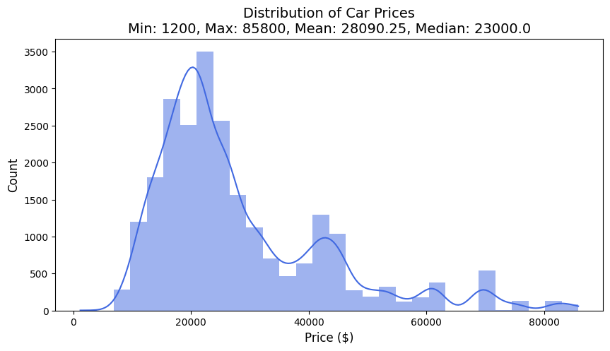
Distribution of Car Prices and the Pricing Variations Factors
The distribution suggests a predominantly mid-range market, with affordability being a key factor. However, the presence of high-priced vehicles indicates a luxury segment that caters to a select audience. The right skewness suggests that while high-end cars exist, they are far less common than standard-priced ones.

Slide 8
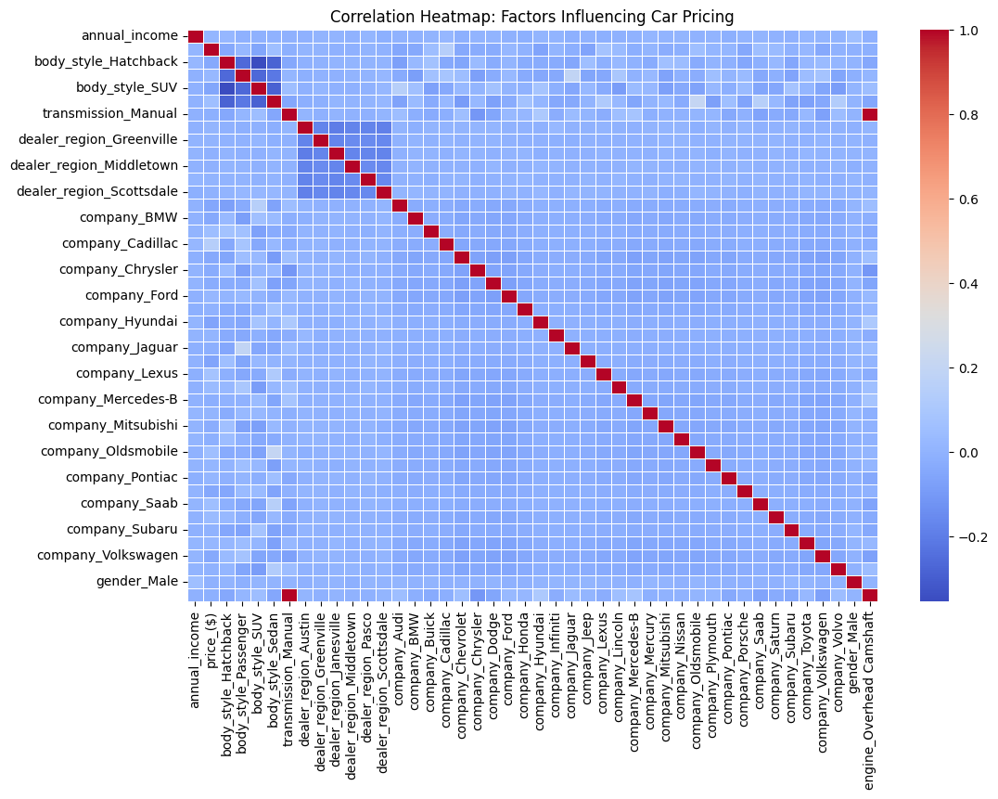
The pricing variations are mainly influenced by combination of performance, brand positioning, and consumer purchasing power as shown in the correlation heatmap.
Notably, annual income exhibits a moderate positive correlation with price, suggesting that higher-income individuals tend to purchase more expensive vehicles. Additionally, engine-related attributes, such as engine type, play a role in pricing variations, indicating that more advanced or high-performance engines contribute to higher vehicle costs.
Interestingly, regional demand patterns may also influence pricing, as seen in the correlations between dealership performance and price. This suggests that dealerships operating in high-demand areas might sell vehicles at a premium.
However, factors such as fuel efficiency (e.g., city MPG and highway MPG) show weaker correlations, implying that pricing is not primarily driven by fuel economy but rather by performance, brand positioning, and consumer purchasing power.

Slide 9
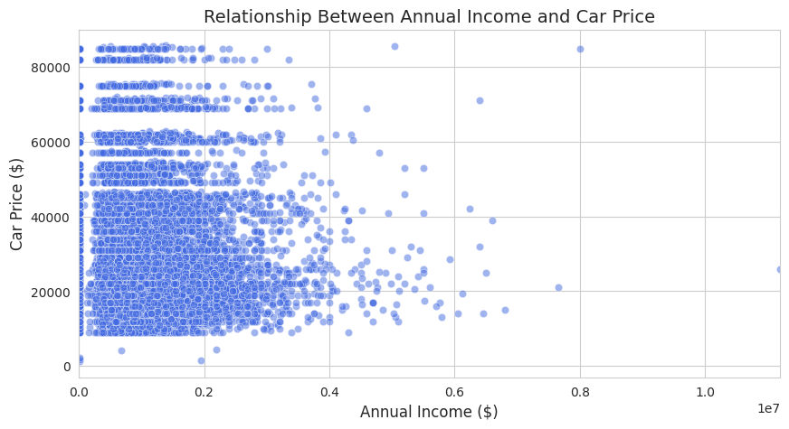
Income vs. Car Price: Understanding Consumer Spending Patterns in the Automotive Market
This analysis reveals a critical insight into consumer purchasing behavior based on income levels. While higher-income individuals tend to invest in premium and luxury vehicles, the majority of car buyers, regardless of income, purchase vehicles within a concentrated price range. This suggests that affordability, financing options, and perceived value play significant roles in purchase decisions.
The data highlights a key trend: even among high earners, spending on vehicles does not always scale proportionally with income. Instead, practical factors such as brand preferences, lifestyle choices, and market availability influence purchasing decisions. For businesses, this underscores the importance of targeting different income segments with tailored marketing, financing solutions, and product offerings to maximize sales opportunities.

Slide 10
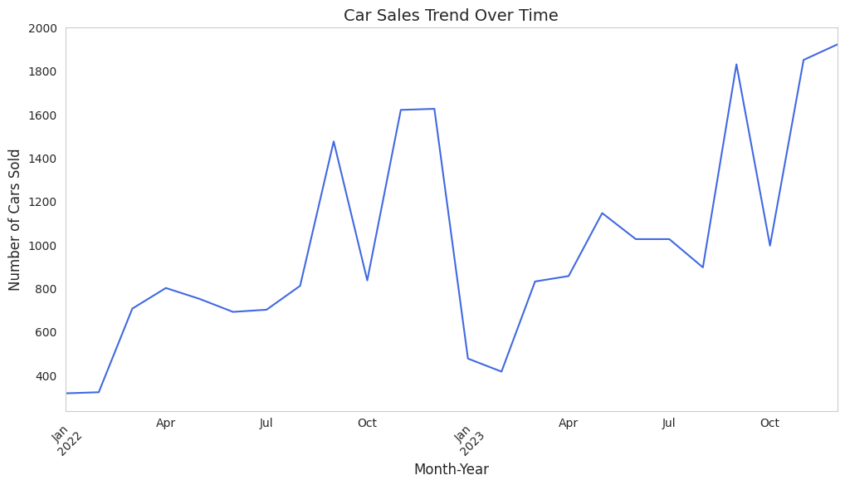
Car Sales Trend
The graph indicates a general upward trend in car sales over time, suggesting growing demand or an expanding market. However, the trend is marked by sharp fluctuations, indicating seasonal or economic influences affecting car purchases.
There are peaks around Q4 (October–December) in both years. This suggests that year-end promotions, holiday discounts, or new model launches may be driving increased sales. Another noticeable rise occurs in mid-year (around May–July), possibly due to mid-year promotions or seasonal demand increases.
Sales drop significantly around January 2023, which might indicate a post-holiday slump when customers hold off on buying after the year-end sales. Another drop in mid-year (around September) could be due to seasonal low demand or supply chain disruptions.

Slide 11
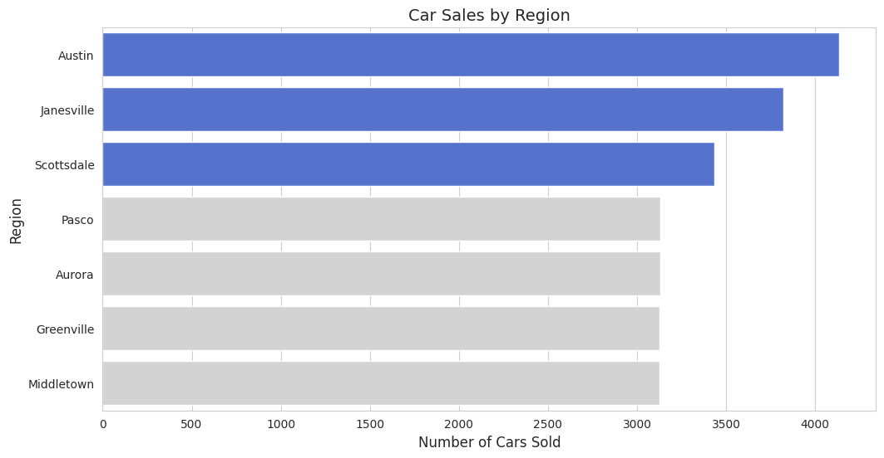
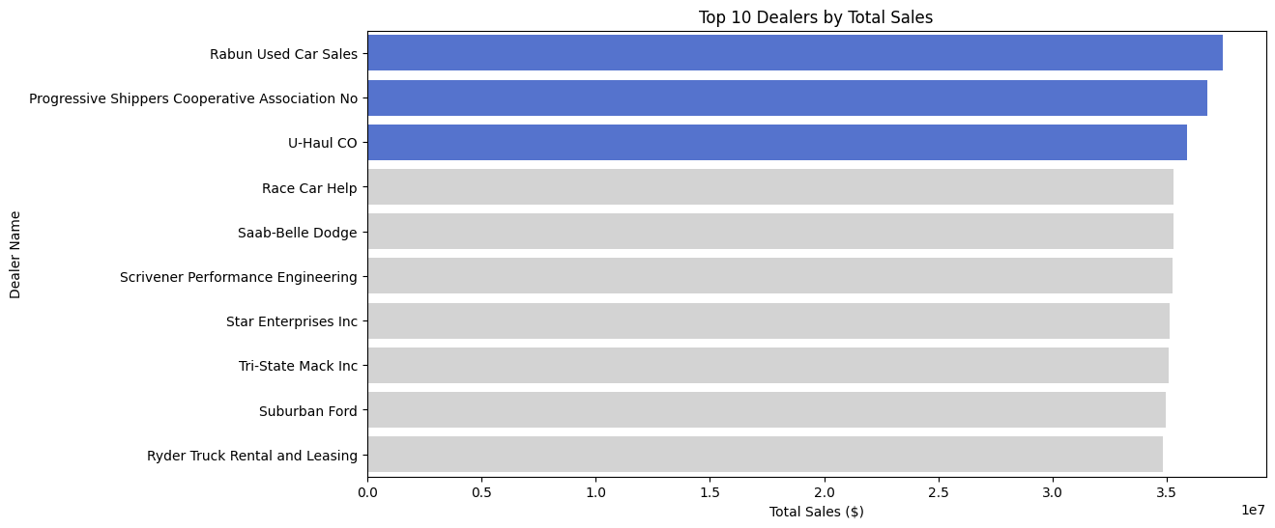
The Correlation between Regional Sales and Dealership Performance
The automotive sales landscape is shaped by a dynamic interplay between regional demand, dealership dominance, and revenue generation strategies. Certain regions, such as Austin, Janesville, and Scottsdale, emerge as clear leaders in total car sales, demonstrating strong consumer demand and potentially well-established dealership networks.
However, selling the most cars does not always translate to the highest revenue, as seen when analyzing top-performing dealerships. A select few, like Rabun Used Car Sales and Progressive Shippers Cooperative Association—do not necessarily align perfectly with the top three selling regions, far surpass their competitors in total sales revenue, signaling that strategic pricing, brand positioning, and operational efficiency are just as vital as raw sales volume.

Slide 12
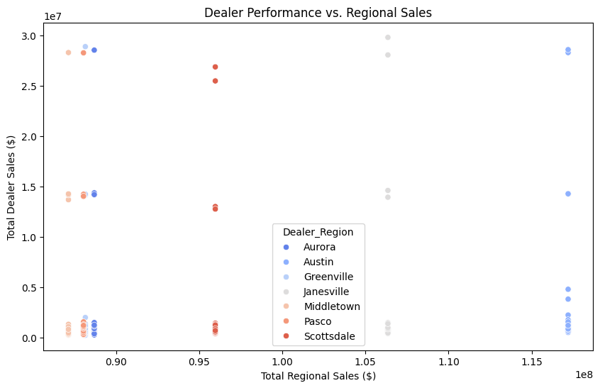
The relationship between total regional sales and individual dealer performance, highlighting variations in dealership dominance across different regions. While some regions exhibit a balanced distribution of sales among multiple dealers, others are driven by a few high-performing dealerships that generate a significant portion of the total revenue. This suggests that dealership success is not solely dependent on regional demand but also on strategic pricing, brand positioning, and operational efficiency. Businesses looking to expand should assess not only regional sales potential but also the competitive landscape to optimize profitability.

Slide 13
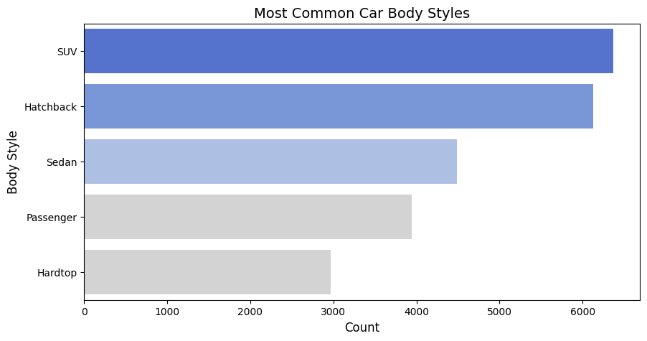
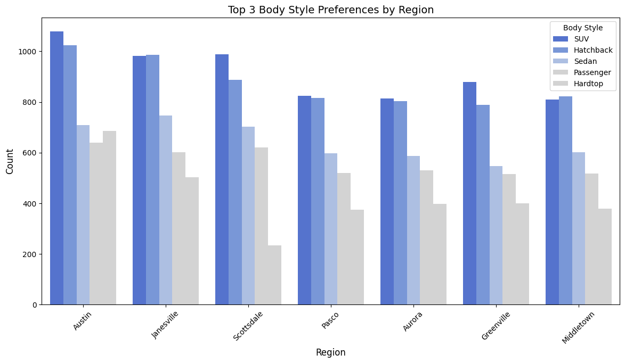
Consumer Preferences of Car Body Styles and Transmission Types
The data highlights key trends in car body style preferences, with SUVs, hatchbacks, and sedans emerging as the most popular choices among consumers, indicating a strong preference for practicality, versatility, and fuel efficiency.
Regional analysis further reveals variations in consumer demand, with SUVs and hatchbacks maintaining a dominant presence across all markets, while sedan sales remain consistently strong. Differences in regional preferences suggest that market conditions, infrastructure, and lifestyle factors play a crucial role in shaping purchasing decisions.

Slide 14
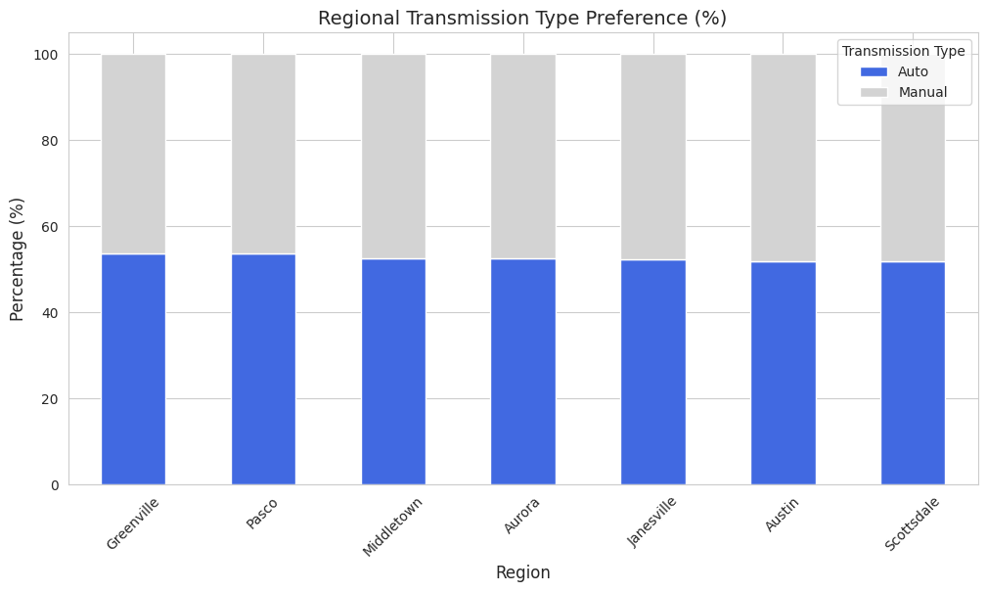
Consumer Preferences of Car Body Styles and Transmission Types
Approximately
12,500
units with automatic transmissions sold in 2022-2023,
compared to 11,500 units for manual transmissions
Regionally, automatic transmissions account for approximately 52–54% of total sales across all locations, while manual transmissions represent 46–48%.
This consistent distribution suggests that while convenience and ease of use drive the preference for automatic vehicles, a substantial segment of consumers continues to favor manual transmissions, potentially due to cost considerations, performance advantages, or regional driving preferences.

Slide 15
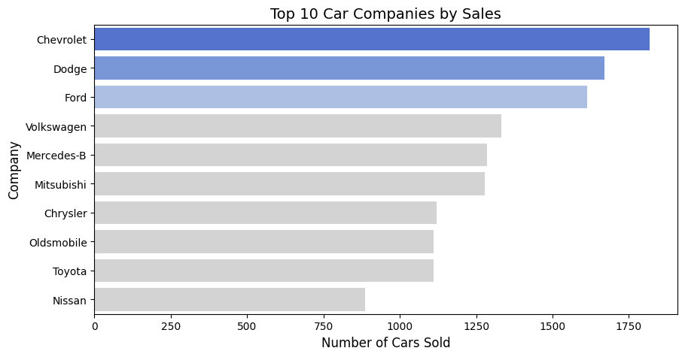
Car Brands/Companies Sales Performance
The data reveals Chevrolet has emerged as the market leader, demonstrating strong consumer demand, effective marketing strategies, and a well-established dealership network. Dodge follows closely, maintaining a solid market presence, while Ford secures the third position with competitive sales figures.
These top-performing brands highlight the importance of brand loyalty, product reliability, and strategic positioning in driving sales success. Meanwhile, brands like Volkswagen, Mercedes-Benz, and Mitsubishi maintain stable performance in the mid-tier segment, reflecting consistent demand. Other brands, including Chrysler, Oldsmobile, Toyota, and Nissan, still hold significant market share but show room for growth and potential improvement in sales strategies

Slide 16
Summary and Suggestion

Slide 17
Summary
The market is largely mid-range, with affordability as a major factor, though a smaller luxury segment caters to high-income buyers. The pricing variations are mainly influenced by combination of performance, brand positioning, and consumer purchasing power.
Wealthier consumers do not always opt for high-end vehicles, emphasizing the role of brand loyalty and perceived value.
Sales trends show a steady increase, with peaks in Q4 (Oct-Dec) due to holiday promotions and mid-year likely influenced by seasonal demand. Conversely, sales drop in January (post-holiday slowdown) and September (potential seasonal or supply chain issues).
Regionally, Austin, Janesville, and Scottsdale lead in sales, but revenue dominance is driven by strategic pricing rather than sheer volume.
SUVs, hatchbacks, and sedans are the most popular body styles, reflecting a preference for practicality and fuel efficiency. Automatic transmissions are slightly more popular, though manual cars still hold a significant market share, possibly due to cost savings or performance appeal.
Among brands, Chevrolet leads, followed by Dodge and Ford, while mid-tier brands like Volkswagen and Mitsubishi show consistent demand.

Slide 18
Suggestions
1. Optimize Pricing Strategies:
Offer targeted promotions during peak seasons (Q4 & mid-year).
Adjust pricing based on regional demand and dealership performance.
2. Target Income-Specific Marketing:
Provide financing solutions for mid-income buyers to increase affordability.
For luxury brands, focus on exclusivity and performance features rather than just price.
3. Enhance Dealership Performance:
Identify underperforming dealerships and invest in marketing or operational improvements.
Expand in high-sales regions like Austin and Scottsdale.
4. Cater to Consumer Preferences:
Focus on SUVs, hatchbacks, and sedans, as they dominate sales.
Offer more automatic transmission options while keeping manual models for budget-conscious or performance-driven buyers.
5. Strengthen Brand Positioning:
Chevrolet, Dodge, and Ford should maintain their market dominance through loyalty programs and promotions.
Mid-tier brands should improve marketing and dealership reach to boost sales.

Slide 19
https://github.com/arsyrahmadani/DQLab
Link Dashboard (Google Looker Studio)
Link Google Colab

